Slide 1
Along the Way to
Master Model Railroader

Slide 2

Notes:
This is where it all began. Christmas late in the 1950’s. Later, my brother received the Santa Fe War Bonnet AA’s and three silver sided passenger cars. Envious? Nah!

Slide 3
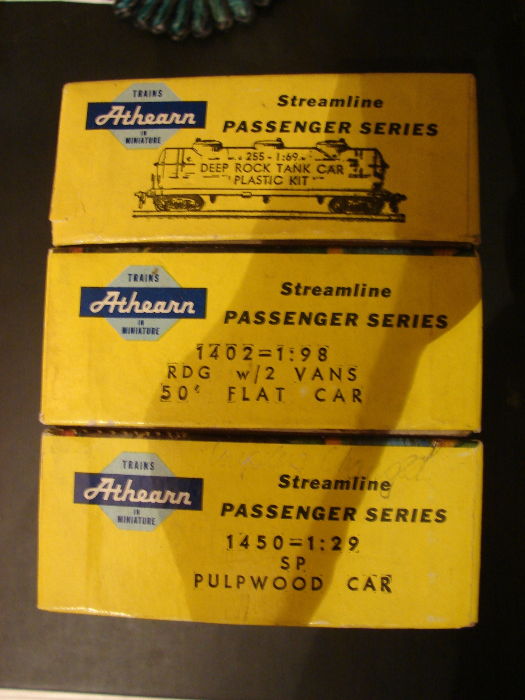
Notes:
Athearn Yellow boxes! Who can forget them? Paid for with newspaper route money, lawn mowing and snow shoveling. Check the prices! Remember rubber band hi-drive?

Slide 4
Why
A travel guide to help your journey through the world of model railroading.
A set of standards
A source of ideas for projects that can help us learn to learn to become better modelers
Notes:
Why strive to complete the NMRA Master Model Railroader Program. And, what is the program? Think of it as a travel guide, a set of standards and a source of ideas. Or, a self contained model railroader personal improvement program.

Slide 5
How Is The Achievement Program Different From MMR
They are the different
They are the same
You can earn Achievement Certificates without ever becoming a Master Model Railroader.
Notes:
Good question. The achievement certificates can and are earned individually. After you have earned 7 certificates, and at least 1 from each of the 4 areas of the Regulations, you become a Master Model Railroader.

Slide 6
Notes:
There are

Slide 7
Numbers
As of September 19,2011:
17,000 NMRA members
454 Master Model Railroaders
Completing the MMR program puts you in the Top 2 % of NMRA members
Notes:
Is this the 2% you aspire to? And the best part is, when you arrive there, there is no secret handshake to remember or username and password to memorize!

Slide 8
Rules
Be a current NMRA member
Complete the requirements for each category
Request certification on a completed AP Statement of Qualification
Notes:
Like most other things in life, there are rules for this journey or achievement. In order to become a Master Model Railroader, you must:
Be a current NMRA member
Complete the requirements for each category
Fill out the paperwork!

Slide 9
NMRA website
Requirements
Some requirements overlap: Civil Engineer steps satisfy points needed in Engineer – Electrical and Chief Dispatcher awards
Statement of Qualifications (SOQ)
Judging matrixes
Notes:
Requirements is a word you will see again, soon. The requirements for Master Model Railroader are listed on the NMRA website at www.nmra.org/Achievement Programs. You will probably visit this site frequently during your journey. Bookmark it.
Some MMR certificate requirements overlap. If you are working on the Model Railroad Engineer – Civil Certificate, print out the Statement of Qualification (SOQ) for Model Railroad Engineer – Electrical and for Chief Dispatcher as you can claim credit for all three certificates by completing one or more of the requirements in Model Engineer – Civil. Fill out all of the paperwork NOW. The SOQ’s for each certificate are on the NMRA website. Also on the website are the judging matrixes you should review for any Certificate that involves judging.

Slide 10
Requirements
Earn 7 of the 11 certificates available
One certificate must be earned in each of the four areas of the Regulations
Golden Spike Award is good practice to start the program but is not necessary for MMR
Notes:
To qualify as a Master Model Railroader, you must complete 7 of the 11 Achievement Certificates available. At least one certificate must come from each of the four requirement categories.
The Golden Spike Award IS NOT required for MMR, however, it is good practice and a good way to hone or blow the rust off of your skills.

Slide 11
Achievement Categories
Railroad Equipment
  Master Builder – Motive Power
  Master Builder – Cars
Notes:
Category One is Railroad Equipment. To satisfy this requirement you must be a Master Builder of either car motive power or cars (all other rolling stock). Latest requirements on the NMRA website are dated 2006 but are still current.
We’ll cover this again, BUT READ THE REQUIREMENTS for each certificate. Point matrices have changed over time.
There IS a difference between contest and layout models.

Slide 12
Railroad Setting
Master Builder – Structures
Master Builder – Scenery
Master Builder – Prototype Models
Notes:
Category Two is Railroad Settings. Here we find out what your motive power and cars run through. Don Hoad, MMR – “remember, a structure is a box (or boxes)”. Don’t complicate things by making it more than that.
Be a modeler first – then DOCUMENT what you are doing
Conformity is the new buzz word. RJD – dinged for using O scale ladder on structure – HO guys can’t climb O scale ladders.

Slide 13
Railroad Construction and Operation
Model Railroad Engineer – Civil
Model Railroad Engineer – Electrical
Chief Dispatcher
Notes:
Paperwork is VERY important here. There a lot of steps and need for good records can’t be stressed enough – Don Hoad

Slide 14
Service to the Hobby and the NMRA
Association Official
Association Volunteer
Model Railroad Author

Slide 15
Ten Tips Plus One
For each Certificate, thoroughly read ALL the requirements for the Certificate, including the “hints” included with the requirements and read ALL the forms. Read everything completely.
Notes:
I call this section of the clinic Ten Tips Plus One. Sounds a lot better to me that Eleven Things You Need To Know.
Tip # 1: This may seem obvious to anyone who can fog a mirror, but the best way to begin a certificate journey is to READ THE REQUIREMENTS on the NMRA website. Read the Tips that are with the requirements. Unless you have a photographic memory, I suggest print the requirements and the supporting forms for review. It makes it a lot easier for me to have the material in front of me rather as opposed to going on line and scrolling through the material again and again.

Slide 16
Ten Tips Plus One
Do Tip #1 again! 90% of all questions about earning an AP certificate can be answers by reading the requirements.
Notes:
Tip # 2: read Tip # 1 AGAIN! According to Fred Bock, Assistant Manager of the NMRA Education Department and a MMR, 90 % of the questions you will have at this point can be answered by re reading the requirements and supporting hints again.

Slide 17
Ten Tips Plus One
Don’t read things into the requirements that aren’t required. You only have to do what the requirements say, no more.
Notes:
Tip # 3: Accept the requirements as they are printed. Don’t try to read anything into the requirements. You have to meet the requirements to be successful, but trying to rewrite them or outsmart them won’t get you to the destination you want.

Slide 18
Ten Tips Plus One
Talk to your Division AP contact BEFORE you get started; tell him/her what you plan to do for the Certificate. See if they agree.
Notes:
Tip #4: Now that you know what you need to do, communicate with your Division AP contact and tell him or her how you plan to meet the requirements you’ve read. Be sure they are in agreement with your plan of attack. In my case, coming to a meeting of the minds is difficult as there is only one mind present in a two way conversation.

Slide 19
Ten Tips Plus One
If you have questions about the requirements after you get started, do Tip #1 again, then talk to your Division AP contact. He/she will be able to decide if what you have planned will meet the requirements.
Notes:
Tip #5: So now you’ve started building or drawing or wiring something and you run into an insurmountable problem. What do you do? First, go back and review Tip #1, AGAIN. If you are still lost, THEN contact your Division AP contact. They should be able to suggest a way around your problem. But what happens if the two of you can’t come to a reasonable solution?

Slide 20
Ten Tips Plus One
If your Division AP contact can’t answer your question, then the TWO of you, together, should contact your Region AP Chair and see if you can get clarification.
Notes:
Tip #6: If, after the consultation with your Division AP, you two haven’t arrived at a workable solution, both of you together should contact your Regional AP chair for a decision

Slide 21
Ten Tips Plus One
If you asked me (Fred Bock) your question, the first things I’d ask are (a) did you read all the requirements and (b) what did your Division AP contact tell you when you asked him that question?
Notes:
Tip #7: Paraphrasing Fred Bock’s comment to me, your Regional AP Chair will probably start off by asking you if you performed Tip one and Tip number two? The next question you will probably be asked is what did your Division AP contact suggest you do when you posed your question to them? Does it sound as if a solution is forth coming to you?

Slide 22
Ten Tips Plus One
If you regard the AP as an educational experience, then the best method to get models assessed and learn more is by “home judging” followed by Division meeting, Region convention, AP assessment, and Region contest judging.
Notes:
Tip #8: Back near the beginning of this session, we discussed how the AP experience is similar to an educational journey. For many of the requirements for MMR, you will have to go through “home schooling”. Contact your Division AP chair and tell them you have some or all of your required cars completed and you’d like to have them judged. He will arrange for two qualified car judges to pay you a visit at home to review your efforts. REMEMBER, they are not “judging” your efforts and accomplishments. They are evaluating your work against their experience to see how you “measure up” with your fleet. They will offer comments as needed as to how you can improve your work before taking it on to a Division, Regional, or National judging venue. This IS NOT a case of “Hi. We’re from the Federal Government and we’re here to help.” This is two or three people who have traveled this road before themselves and are offering their time and expertise to see how you measure up to other MMR’s. Learn from what they have to say.

Slide 23
Ten Tips Plus One
Locomotive and rolling stock models for AP assessment have to be “operational”, (See the Requirements). Contest models DO NOT have to be operational. Check with your Division AP contact for his definition of “operational”. In some cases, some detail (underbody) may have to be modified or omitted for the model to be “operational”.

Slide 24
Ten Tips Plus One
Look for opportunities to use work done on one certificate to be applicable to others. For example: Civil Engineer, Electrical Engineer and Chief Dispatcher all require a diagram of the layout track plan.

Slide 25
Ten Tips Plus One
Fill out the “paperwork” as you go along; don’t put it off until you’re all done.
Notes:
Tip # 11: Probably, Tip 11 ought to be Tip 3. Do your paperwork as you go along. DO NOT wait until the last bit of wiring is completed, the last paint or hydrocal is dry or the last operation session is completed. DO IT NOW. As an example, your need 10 hours as Dispatcher as part of the Dispatcher Certificate. Now, your memory is probably a lot better than mine. But if you need, for example, three sessions to accumulate 10 hours, what are the chances at the end of the last session you will remember the locations, dates, names of the layout owners AND their NMRA member numbers for your records if you don’t write them down immediately after each session?
And after you’ve written down all the information, MAKE A COPY FOR YOURSELF. Remember, you have to send all of your documentation to someone else for review, and if it gets lost in transit……?

Slide 26
Resources
Judges
NMRA Scale Rails article series 2008. Found at http://nmra.org/education/achievement/midx.org
NMRA Regional/Chapter AP officials Northeastern Division – William (Bill) Brown larcproducts@ yahoo.com
Hub Division – Don Howd hub.ap.chair@hubdiv.org

Slide 27
Resources
Kalmbach Library
Railroad Historical Societies
Historical Societies
Internet
State archives
Architectural websites
Prototypes – even if they are not yours
Mk 1 Mod A eyeball
Notes:
Eyeball – add detail. No gutters or downspouts

Slide 28
Resources
Judging Guidelines for Motive Power, Structures and Cars
On NMRA website under Achievement Program/General Forms
Tells you how your models will be judged
May help you design or conceptualize projects at the planning stage

Slide 29
How Do I Do It?
Document (fill out the paperwork) everything you’ve all ready done
Concentrate on one Certificate at a time vs. shotgun approach
DON’T GET BORED
Use the other certificates for a change of pace
Do something, but record it

Slide 30
How Do I Do It?
Do it when you feel like it: don’t when you don’t
Keep it FUN
Set goals
Have fun with it

Slide 31
Recordkeeping
Binders
Spreadsheet
Signals
Keep copies of everything
Notes:
Binders: size DOES matter despite what you’re told. Starting out, I have a three ring binder I keep all my paper records in. If I knew how to use my scanner, I’d keep copies of everything there and back it up weekly. As a part of the Author Certificate, you need to keep copies of any and all articles you write. I’ve not heard if you can just provide links to your work or not, but this may be a case where paper wins out.
Spreadsheet: I use a spreadsheet I received from another member. I modified it to suit my needs. In this spreadsheet, I have listed the requirements, the dates I did what, and collected the NMRA numbers and names of those who signed off on the various accomplishments.
One of the contributors to this presentation told me he completed all of the requirements for one of the certificates and mailed everything off for further review. Years later, he began to trace the lost plaque only to find his documents never made it to one of the required signatories. If he had had a copy of what he submitted, life could possibly been more enjoyable.

Slide 32
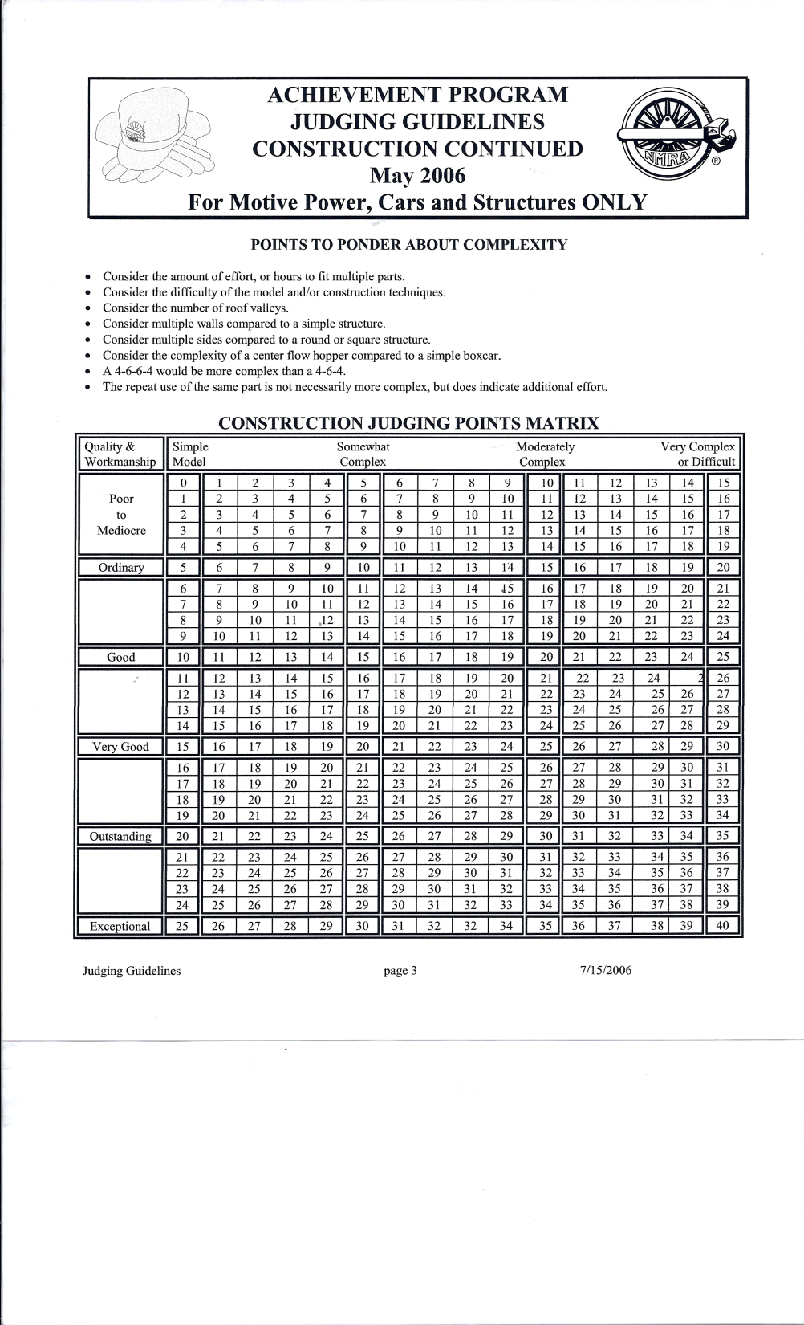
Plan Ahead

Slide 34
Acknowledgements
National Model Railroad Association – NMRA
NMRAAP Yahoo Group
Notes:
This clinic would not have been possible without the contributions from many sources. The most important contributor obviously was the NMRA through their website and membership. Thanks, guys (and gals).
Second, if you have not all ready become a member of the NMRA AP Yahoo group, I strongly encourage you to do so. The members of the group are either pursuing MMR or have all ready received the award and are “giving back” through their time and efforts on the board. Best part? It’s free!

Slide 35
Contributors
Phil Bonzon, MMR 427
Fred Bock, MMR, Assistant Manager, NMRA Education Department
Jack Dziadul, Hub Division
Pete Watson, MMR
Dave McPherson, MMR
Ken Belovarac, 3/7’s MMR
Ralph DeBlasi - on the journey
Don Howd – Hub Division Chair
Notes:
All of the individuals listed here provided comments, critiques, experience and encouragement. Note the absence of the word criticism. Just as in the judging phase of the program, I did receive constructive comments, but in the spirit of the endeavor, no criticism.

Slide 36
Contributors
Norm Frowley, MMR
Bob Hamm, MMR

Slide 37
Not an ad for shoes……..

Slide 38
JUST DO IT!

